Slide 1


AWS Lambda Deployment
using Terraform

Slide 2
Here we can see how to deploy an AWS Lambda function using Terraform. It includes setting up an IAM role, attaching policies, packaging the function, and deploying it.
Terraform setup :
1. AWS Provider Configuration
This specifies that Terraform will use AWS as the cloud provider.
The region is set to us-east-2, all resources will be created in this AWS region.
provider "aws" {
region = "us-east-2"
}

Slide 3
2. Creating an IAM Role for Lambda
resource "aws_iam_role" "lambda_role" {
name = "aws_lambda_role"
assume_role_policy = <<EOF
{
"Version": "2012-10-17",
"Statement": [
{
"Effect": "Allow",
"Principal": {
"Service": "lambda.amazonaws.com"
},
"Action": "sts:AssumeRole"
}
]
}
EOF
}
A new IAM role named aws_lambda_role is created.
The role allows AWS Lambda to assume it as sts:AssumeRole.
The lambda.amazonaws.com service principal means this role is specifically for AWS Lambda.

Slide 4
3. Creating an IAM Policy for Logging
resource "aws_iam_policy“ "policy_lambda" {
name = "aws_lambda_policy"
policy = <<EOF
{
"Version": "2012-10-17",
"Statement": [ {
"Effect": "Allow",
"Action": [
"logs:CreateLogGroup",
"logs:CreateLogStream",
"logs:PutLogEvents"
],
"Resource": "arn:aws:logs:*:*:*"
} ]
}
EOF
}
The IAM policy permissions to write logs to Amazon CloudWatch.
Actions allowed:
logs:CreateLogGroup: Create a new log group.
logs:CreateLogStream : Create a new log stream.
logs:PutLogEvents : Write log events to CloudWatch.
The Resource is set to "arn:aws:logs:*:*:*" to apply this permission across all logs.

Slide 5
4. Attaching the Policy to the IAM Role
resource "aws_iam_role_policy_attachment" "attach_policy“
{
role = aws_iam_role.lambda_role.name
policy_arn = aws_iam_policy.policy_lambda.arn
}
This attaches the IAM policy to the IAM role.
Ensures that the Lambda function will have the necessary permissions to write logs to CloudWatch.

Slide 6
5. Packaging the Lambda Function
6. Creating the Python Lambda Function
Uses Terraform's archive_file resource to package the Lambda function as a ZIP file.
The source_dir specifies the directory where the Python function is stored.
The output is stored as "hello-lambda.zip" in the same directory.
Inside your Terraform project, create the following folder structure:
/terraform_project
├── main.tf
├── python/
│ ├── hello-lambda.py
resource "archive_file" "zip_file" {
type = "zip"
source_dir = "${path.module}/python"
output_path = "${path.module}/python/hello-lambda.zip"
}
Inside python/hello-lambda.py, write the following Lambda function:
import json
def lambda_handler(event, context):
return {
"statusCode": 200,
"body": json.dumps("Hello from AWS Lambda!")
}
The function takes event and context as input.
It returns an HTTP response with status code 200 and a simple JSON message.

Slide 7
7. Packaging the Lambda Function
8. Deploying the Lambda Function
Now, Terraform deploys the Lambda function:
To deploy this Python function, we need to package it into a ZIP file:
filename: Uses the packaged ZIP file.
function_name: Assigns a name to the Lambda function.
role: Connects the IAM role for execution permissions.
handler: Points to the function inside hello-lambda.py.
runtime: Uses Python 3.12.
resource "archive_file" "zip_file" {
type = "zip"
source_dir = "${path.module}/python"
output_path = "${path.module}/python/hello-lambda.zip"
}
Terraform compresses the python/ directory into hello-lambda.zip.
This ZIP file is used in the next step to create the Lambda function.
resource "aws_lambda_function" "my_function" {
filename = archive_file.zip_file.output_path
function_name = "lambda-function"
role = aws_iam_role.lambda_role.arn
handler = "hello-lambda.lambda_handler"
runtime = "python3.12"
depends_on = [aws_iam_role_policy_attachment.attach_policy]
}

Slide 8
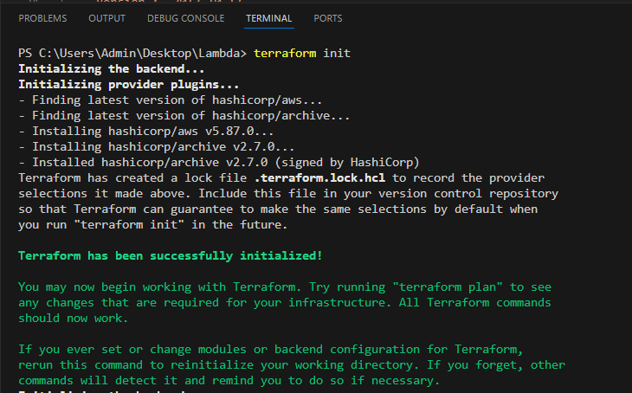
Steps to Initialize, Plan, and Apply Terraform
Now that we have our Terraform configuration and Python Lambda function, let's go through the Terraform commands to deploy it.
Initialize Terraform
Run terraform init to:
Download and configure the necessary provider plugins.
Prepare the working directory for Terraform usage.
Ensure the backend configuration (if defined) is initialized.
Validate Terraform Configuration (Optional)
Use Terraform validate to check the syntax and integrity of the Terraform files.

Slide 9
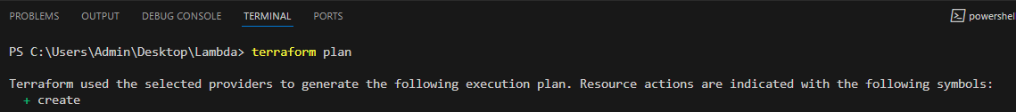
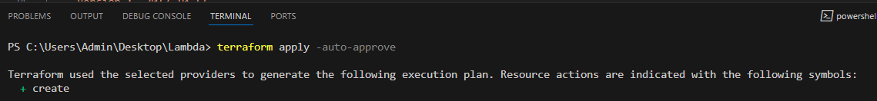
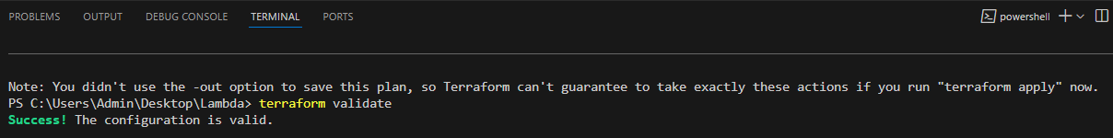
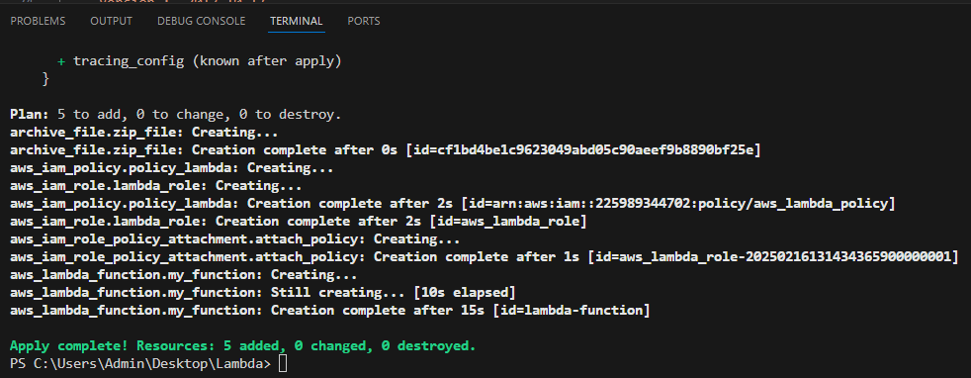
Plan Terraform Execution
Run terraform plan to:
Apply Terraform Configuration
Execute terraform apply to:
Provision and configure resources as defined in your Terraform files.
Review and confirm the changes if prompted.
Preview the changes Terraform will make to your infrastructure.
Ensure the configurations are correct before applying changes.

Slide 10
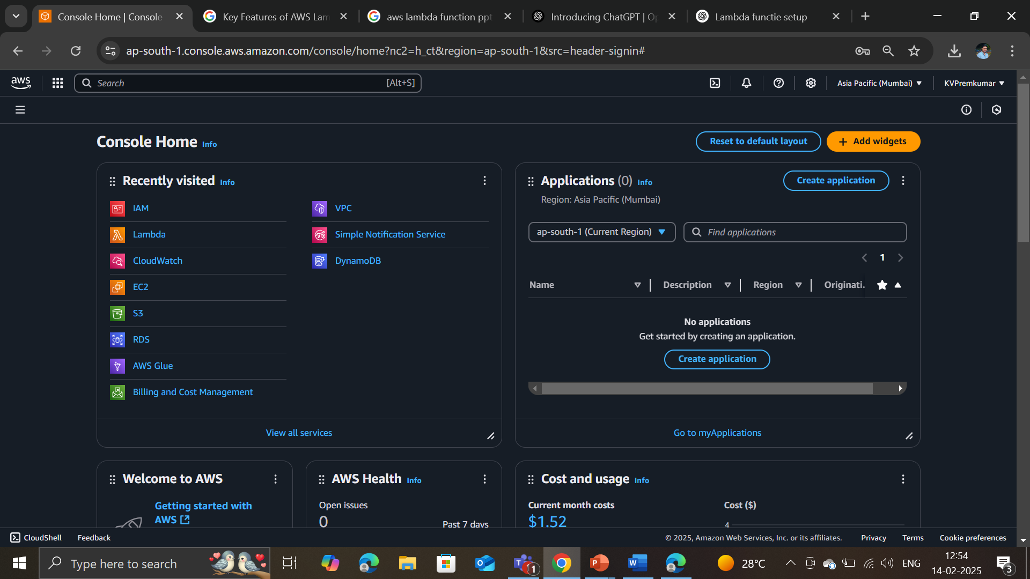
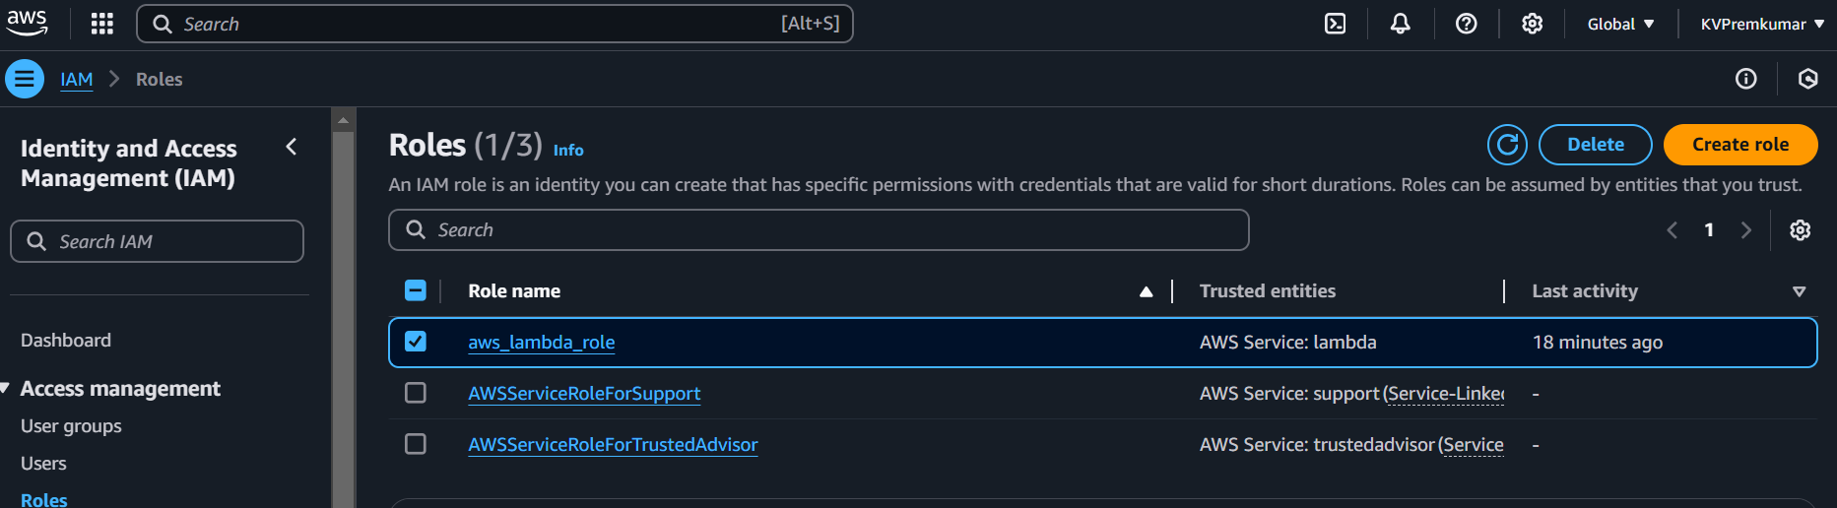
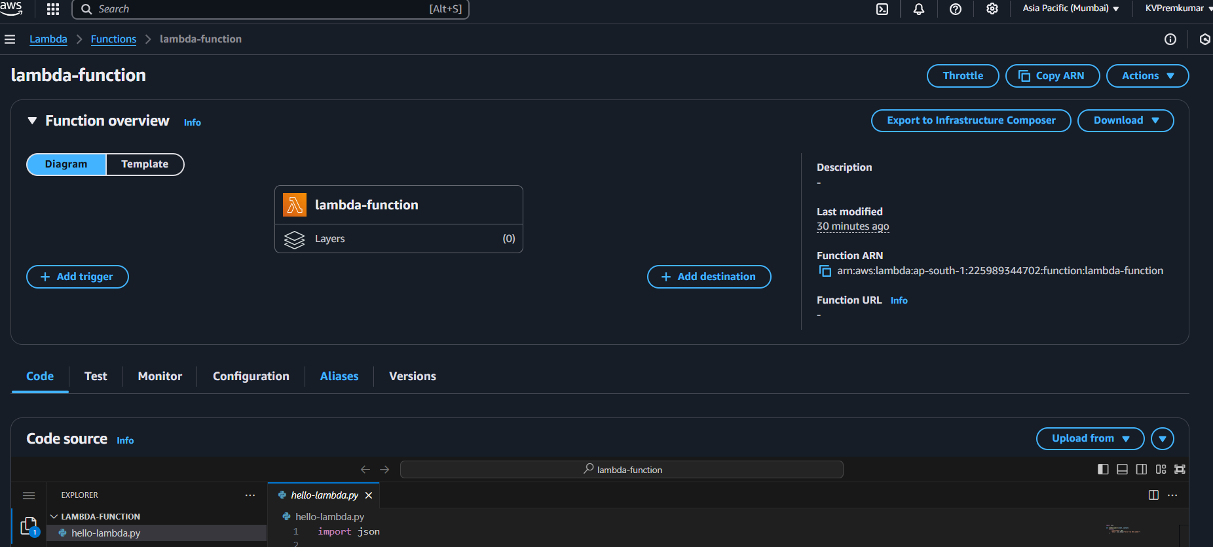
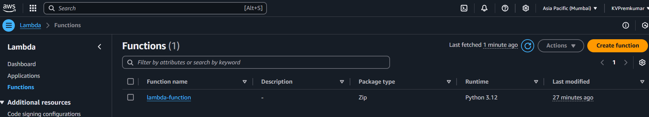
Verification Steps in AWS Management Console
Log in to AWS Console and review the credentials created in the Terraform code.

Slide 11
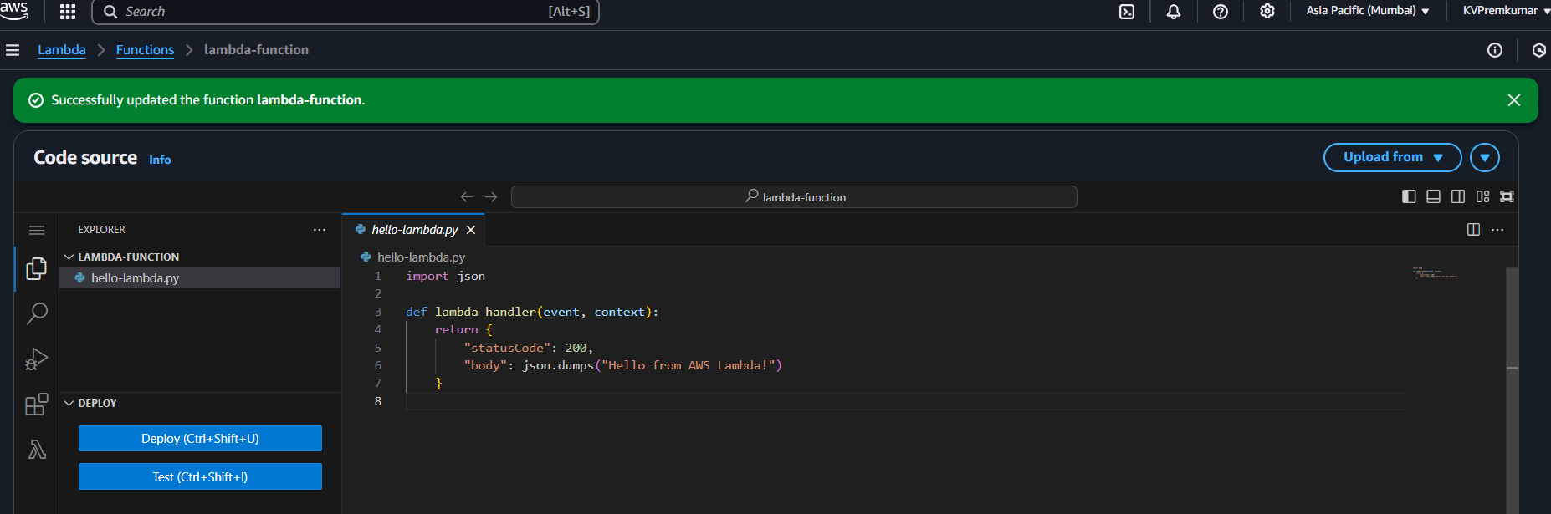
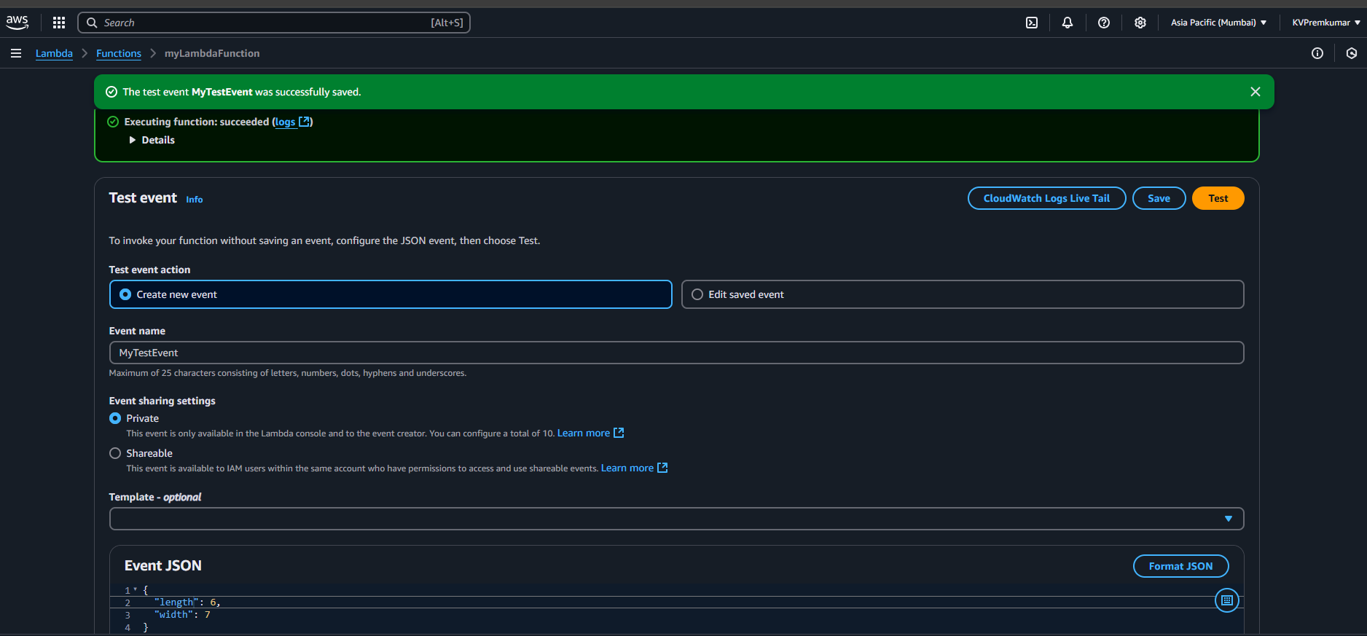
Testing the Function
Scroll down to view the JSON code presented below using Terraform.
Create a test event
Define event name ‘myTestEvent’.
Edit the parameters in the Event JSON.
Save and Run the function.

Slide 12
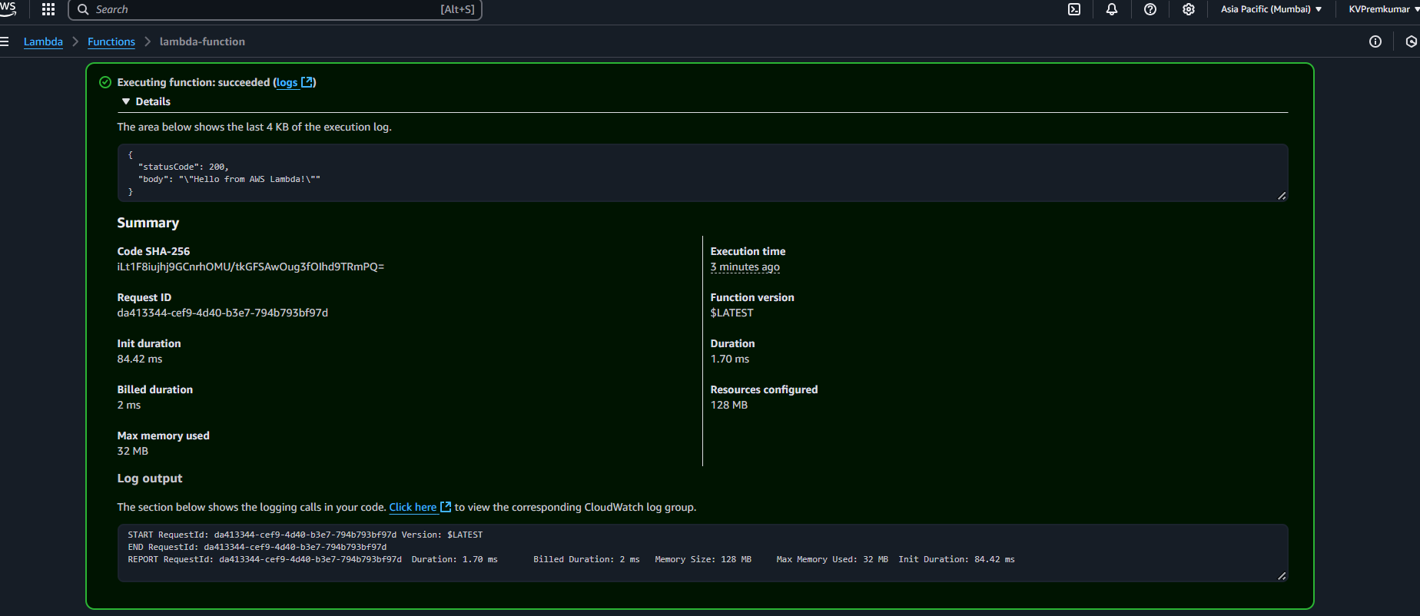
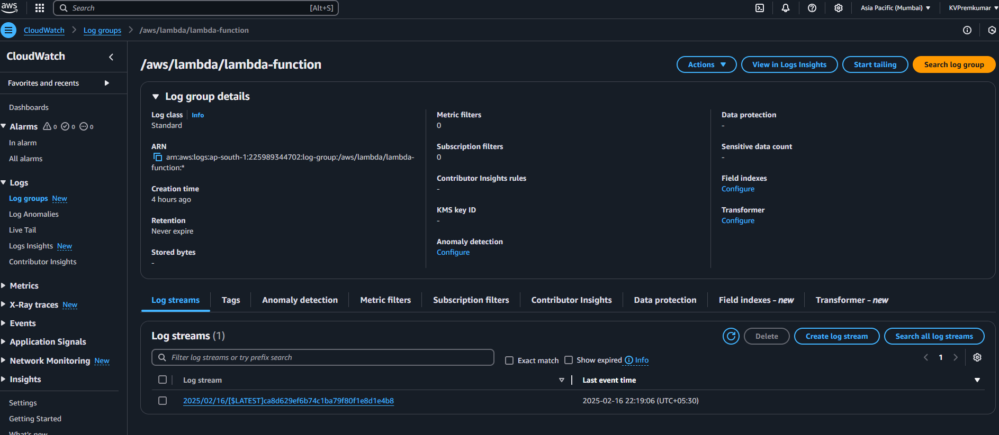
Monitoring
View Output details in the Executing function.
View the recorded logs stored in CloudWatch under the Log streams.

Slide 13
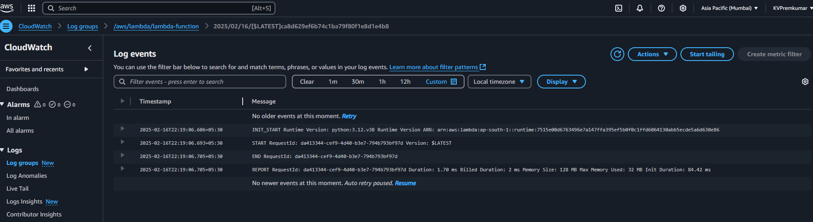
Final Output is displayed in Log events.
Note: AWS CloudWatch Logs automatically stores these logs, helping you debug and monitor your function’s performance.

Slide 14
Conclusion
AWS Lambda provides a scalable, cost-effective, and event-driven solution for running serverless applications.
Key Takeaways:
✔ No need to manage servers
✔ Automatic scaling
✔ Secure and integrates well with AWS services
✔ Ideal for real-time processing and automation

Slide 15
Thank You
Presented by Team-3

